Slide 1
What are we entitled to
when we pay contributions?

Slide 2
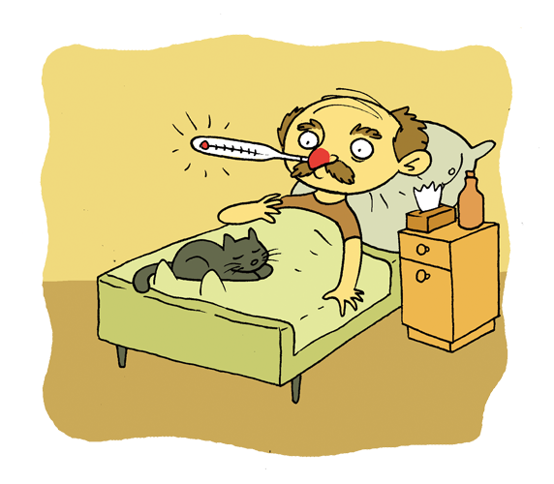
Sickness insurance
Sickness allowance – you will get it instead of your salary if you are insured and you are on sick leave.
Sickness allowance amounts to:
80% of your salary (average of 12 months),
70% of your salary when you are hospitalised,
100% of your salary (also if you are hospitalised), if your inability to work is caused by an accident on the way to work or from work, medical examinations for candidates for donors of cells, tissues and organs, the procedure of their collection, or if you are pregnant.
Who pays out sickness allowance?
Employer who employs more than 20 people,
and in other cases ZUS.
Notes:
Sickness allowance is paid for the period of incapacity for work caused by illness, but not longer than 182 days, and if the incapacity for work results from tuberculosis or occurs during pregnancy - for a maximum of 270 days.
The allowance for the period of stay in hospital is 70% of the salary, because the patient has less expenses during this period.
The allowance in the amount of 100% of the salary is when the person is unable to work, because he underwent medical examinations for candidates for donors of cells, tissues and organs and the procedure of their collection (also for the period of stay in the hospital).

Slide 3
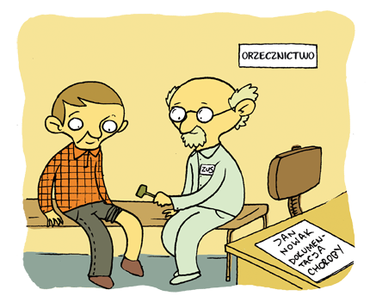
Rehabilitation benefit is granted when:
after the maximum period of receiving sickness allowance (182 or 270 days), you will still be incapable of work,
you are expected to regain your ability to work after further treatment or rehabilitation.
The maximum time of receiving benefit: 12 months.
The rehabilitation benefit amounts to:
90% of the salary for the first 90 days and 75% of the salary during the remaining period,
100% of the salary for a pregnant woman who is incapable of work.
Notes:
3
Incapacity for work is certified by ZUS medical examiner.
You can file an objection against the decision of the medical examiner to the medical commission.
On the basis of the decision of the medical examiner or medical commission, ZUS issues a decision on granting a rehabilitation benefit.

Slide 4
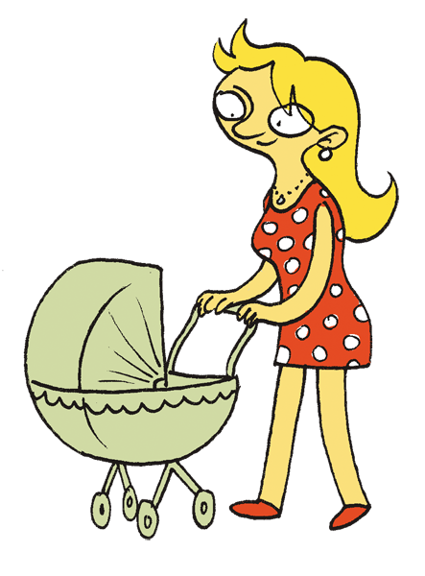
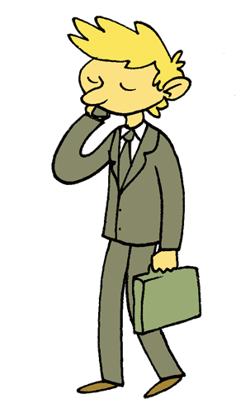
Maternity allowance is granted after the childbirth or the adoption of a child. You will receive it if you are covered by sickness insurance:
obligatory, e.g. as an employee,
voluntarily, e.g. as a person running a business or a contractor.
The maternity allowance is paid for a period determined by the provisions of the Labour Code as:
maternity leave (granted after childbirth),
leave on the conditions of maternity leave (granted after adopting a child),
parental leave (granted after childbirth or adoption of a child),
paternity leave (granted after childbirth or adoption of a child).
The period of payment of the maternity allowance for the period of maternity leave (or leave on the conditions of maternity leave) depends on the number of children born or adopted, e.g. 20 weeks (140 days) after birth / adoption of one child.
Notes:
If an employee gives birth to a child (children), she is entitled to maternity leave, and if the employee adopts a child (children) she or he is entitled to leave on the conditions of maternity leave. The periods of these leaves are defined in the Labour Code.
Maternity allowance is payable for the period of maternity leave or leave on the conditions of maternity leave.
If an insured person who is not an employee (e.g. entrepreneur, contractor) gives birth or adopts a child, he or she will not be entitled to leave but can receive maternity allowance (for a period that corresponds to maternity leave or maternity leave).
The child's mother can decide not to receive her maternity allowance if she received it for at least 14 weeks after giving birth. Such a situation is only possible when the insured child's father applies for a maternity allowance for the remaining period (immediately after the date of resignation from part of the maternity allowance by the mother).
Maternity allowance in the amount of 100% of the salary (average from 12 months) is paid for the period of maternity leave, leave on the conditions of maternity leave and paternity leave (or periods that correspond to those leaves for insured persons other than employees).

Slide 5
Directly after the maternity allowance for the period of maternity leave (or leave on the conditions of maternity leave), you can take the maternity allowance for the period of parental leave, e.g. for 32 weeks – after birth or adoption of one child.
Parents can share their maternity allowance for the period of parental leave.
When you become a father, you will be entitled to:
maternity allowance for the period of paternity leave (maximum 2 weeks),
maternity allowance for the period of maternity leave (or leave on the conditions of maternity leave), if the mother of the child uses at least 14 weeks of this allowance and resigns from the further part.
The amount of maternity allowance:
for the period of maternity leave, leave on the conditions of maternity leave and paternity leave – 100% of salary (average from 12 months),
for the period of parental leave – 100% of the salary for the first 6 weeks and 60% of the salary for the following weeks (if within 21 days after delivery you apply for maternity allowance)
for the entire period of maternity and parental leave – the allowance will be 80% of the salary throughout the whole period.
Notes:
Maternity allowance for the period of parental leave is also granted to the person who adopts a child. This is of course possible if the parent uses the maternity allowance for the period of full maternity leave.
The maternity allowance for the period that corresponds to the parental leave may also be used by insured persons other than employees.
Parents can share their maternity allowance for the period that corresponds to parental leave.

Slide 6
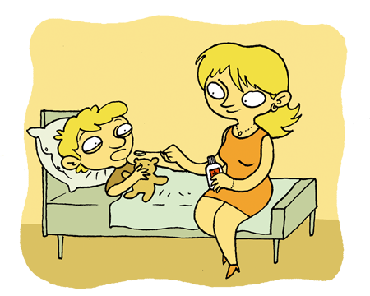
You will receive care allowance when you are insured and you have to take care of:
sick child up to 14 years of age (up to 60 days a year),
healthy child up to 8 years of age, including the following reasons: unforeseen closing of the nursery, illness of a parent who looks after the child (60 days a year),
other sick family members (spouse, child's parent, parent, stepfather, stepmother, father-in-law, grandfather, grandson, siblings and child over 14 years old) if you live with him during the illness (14 days a year).
You can receive care allowance maximally 60 days a year.
Care allowance amounts to 80% of salary (average from 12 months).
Notes:
Both the mother and the father of a child are entitled to care allowance. However, it can be used by one parent at a time – the one who applies for its payment for a given period.
You are entitled to a care allowance if there are no other family members who could provide care for a child or other member of the family. However, this does not apply to the care of a sick child aged up to two years – then care allowance is granted even when there are other family members who could look after him/her.
The total period of payment of care allowance cannot exceed 60 days in a calendar year and it does not depend on:
the number of children and family members who require care,
causes of care,
persons entitled to this allowance.

Slide 7
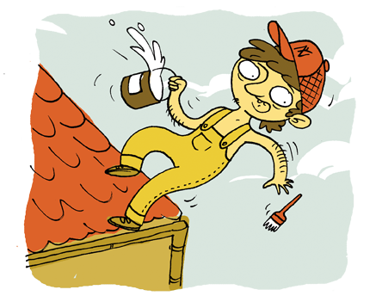
Work accident insurance
You will get benefits from this insurance if you are unable to work due to an accident at work or an occupational disease. Sickness allowance and rehabilitation benefit will amount to 100% of the salary (average of 12 months).
Additionally, you can receive, among others:
lump-sum compensation – for permanent or long-term bodily injury, which will be assessed by ZUS medical examiner or ZUS medical commission when you finish medical treatment (20% of the average national salary – for each percent of bodily injury),
accident pension – if you have become totally or partially incapable of work due to an accident at work or an occupational disease.
Notes:
Accident at work – a sudden event caused by an external cause that occurred during performing work and caused bodily injury or death.
Occupational disease – a condition caused by harmful factors that occur in the workplace or result from the way in which the person performs professional duties. The list of occupational diseases is included in the regulation of the Council of Ministers.
Permanent bodily injury – injury that limits your ability and does not give you hope for full recovery.
A lump-sum compensation for an accident at work or occupational disease for each percentage of permanent or long-term bodily injury is PLN 809 (from April 1, 2017 to March 31, 2018).

Slide 8
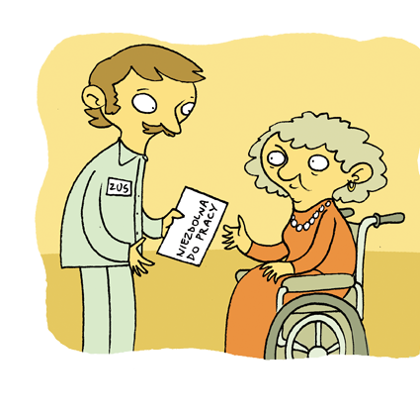
Pension insurance
You can get a disability pension if ZUS medical examiner or ZUS medical commission issues a certificate of incapacity for work. Pension is granted due to incapacity for work, not disability.
Granting the pension also depends on:
the date when the incapacity for work occurred,
contribution and non-contribution periods, the number of which must be relevant to the age at which the incapacity for work appeared,
no right to an old-age pension from the Social Insurance Fund.
Notes:
Disability does not always mean incapacity for work. Disability and incapacity for work are two different notions. People with disabilities can be just as good employees or even better than non-disabled people. It happens that even people fully incapable of work take up an employment – they find a different area of ​​activity and ZUS does not impose any restrictions here.
The pension paid by ZUS is granted due to incapacity for work, not disability.
Insurance period is the sum of (years, months and days):
contribution periods, among others:
being an employee,
conducting business activity and payment of old-age and disability insurance contributions,
active military service in the Polish Army,
non-payment of old-age and disability pension contributions if a person exceeded the amount of the annual contribution calculation basis during the calendar year,
paying social insurance contributions before November 15, 1991 or not paying the contributions during this period, because there was no such obligation,
and
non-contribution, during which insurance contributions are not paid, but they have impact on the right to a pension (e.g. period for which you were entitled to sickness allowance or rehabilitation benefit, period of higher education).
When ZUS evaluates insurance periods, non-contribution periods cannot be longer than ⅓ of contribution periods.
Disability pension is granted to a person who meets all the following conditions:
is unable to work (and has got certificate issued by ZUS medical examiner or ZUS medical commission),
has got an insurance period (mentioned below) which is appropriate for the age in which the incapacity for work appeared,
incapacity for work occurred during contribution or non-contribution periods specified in the regulations (e.g. while being an employee, receiving sickness or care allowance, rehabilitation benefit) or not later than 18 months from the end of these periods.
Insurance period (contribution and non-contribution period) which must be proven to receive a disability pension for work is:
1 year – if incapacity for work appeared before the age of 20,
2 years – if incapacity for work appeared between 20 to 22 years of age,
3 years – if incapacity for work appeared between 22 to 25 years of age,
4 years – if incapacity for work appeared between 25 and 30 years of age,
5 years – if incapacity for work appeared after the insured turned 30.
For how long ZUS grants a disability pension?
Usually, ZUS medical examiner or ZUS medical commission certifies incapacity for work for a maximum of 5 years. If, however, according to medical knowledge, there is no prognosis that the person will regain the capacity for work before the end of this period, they may issue a certificate for more than 5 years. Disability pension is due for the period for which ZUS medical examiner or ZUS medical commission issues a certificate on incapacity for work.
If the right to a pension expires and the person does not regain the capacity for work, he may apply for another pension.

Slide 9
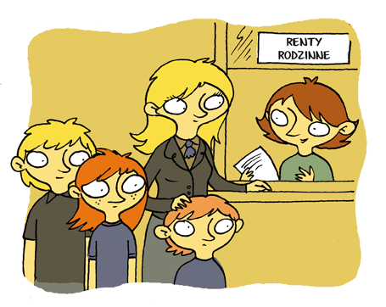
Survivor's pension – you can get it when you are a family member of the deceased who:
was entitled to an old-age or disability pension,
met the conditions to obtain an old-age or disability pension.
You can obtain a survivor's pension, when you are a child of the deceased (also an adopted child) or a stepchild.
Survivor's pension amounts to:
for one person – 85% of the pension that would be payable to the deceased,
for two people – 90%,
for three and more people – 95%.
Notes:
9
Survivor's pension is also granted to eligible family members of a person who at the moment of death was receiving pre-retirement allowance, pre-retirement benefit or teachers compensatory benefit (in this case, it is assumed that the deceased person met the conditions to obtain a disability pension).
All eligible family members are entitled to one survivor's pension. If necessary, it is shared equally among all eligible family members.
Children, stepchildren, and adopted children are entitled to a survivor's pension:
until they turn 16,
if they are over 16 until they finish school, but no longer than up to 25 years of age (if a child reaches 25 years of age at the last year of higher education, s/he is entitled to a survivor's pension until the end of this academic year),
if they have become completely incapable to work before the age of 16 or while studying before the age of 25.
You can use the supplementary text "Benefits for paying contributions" – Pension insurance.

Slide 10
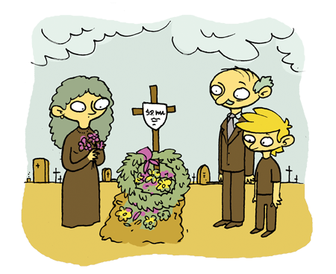
You will receive a funeral grant if you cover the costs of the funeral:
of an insured person, e.g. an employee,
a person who was obtaining benefit from ZUS, e.g. old-age pension,
a family member of the insured person or a pensioner.
The amount of the funeral grant: a maximum of PLN 4,000.
If you are a family member of the deceased's and organize a funeral, you will get PLN 4,000 (regardless of the costs).
If you are not a member of the deceased's family, ZUS will pay a benefit in the amount of the costs incurred – a maximum of PLN 4,000.
Notes:
10
Family members include:
spouse (widow and widower),
parents, stepfather, stepmother and, adoptive parents,
own children, stepchildren, adopted children, and children placed in a foster family,
accepted for raising and maintaining other children before reaching majority,
siblings,
grandparents,
grandchildren,
persons over whom the court has established legal protection.

