Slide 1
Old-age pensions in Poland and worldwide

Slide 2
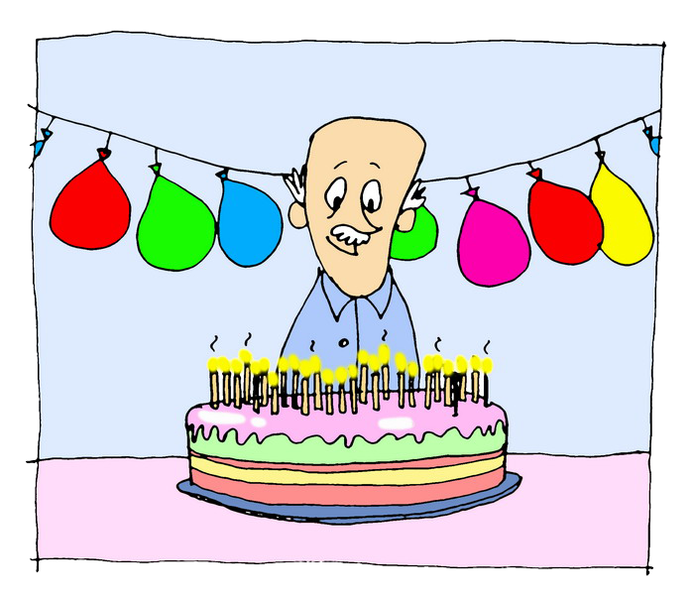
Old-age pension
is supposed to secure life in old age, when you will not be able to work anymore.

Slide 3
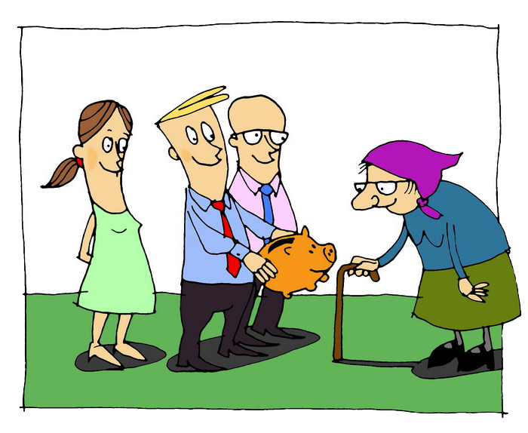
Inter-generation agreement (solidarity)
Contributions paid now by the professionally active
are paid out to current pensioners.
Notes:
We refer to Lesson 1, during which we talked about how the Polish pension system was created. The idea of ​​intergenerational solidarity was shaped at the turn of the 19th and 20th century. It was a response to the liberal philosophy according to which the self-interest is more important than the common good. As we age, we lose strength and must use the help of other people, care or infrastructure maintained by the whole society.
We can refer to student's sentences:
Social insurance is important because:

Slide 4
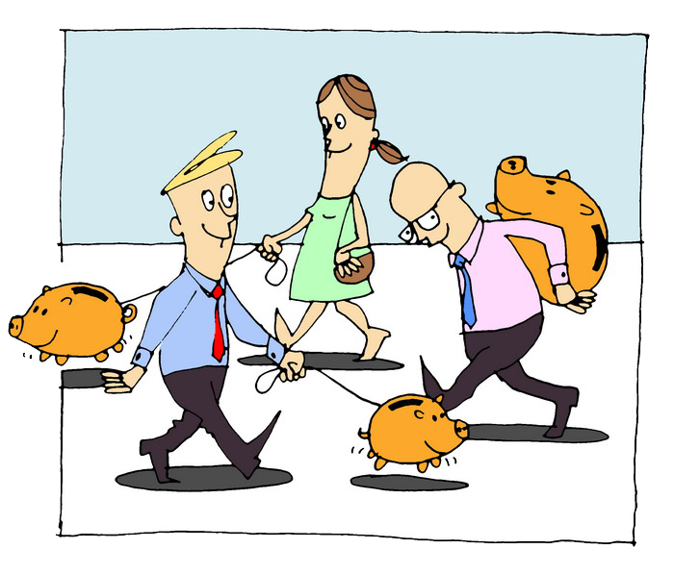
The reform of the universal pension system in 1999 transformed the model of system:
from
DEFINED BENEFIT
to
DEFINED CONTRIBUTION
Notes:
Why was the reform of the pension system necessary? This is a consequence of the aging of society. From the forecast of the Office of the Government Plenipotentiary for Reform of Social Security showed that in the future too few people will work for one old-age pensioner.
The purpose of the reform was not only to guarantee the payment of pensions to all insured persons in the future, but also to link the amount of contribution paid to the amount of the future benefit more closely. The pension system, which was in Poland until 31 December 1998, was a defined benefit system. In such a system there is no relation between the amount of contribution paid and the amount of future old-age pension.
In the pension system which is being implemented from 1 January 1999, the main rule is: the more you pay, the more you get. The amount of the future old-age pension depends solely on: the sum of the contributions paid, the situation on the labour market or the efficiency of investing funds accumulated in open pension funds. Defined contribution system requires the insured to make sure his employer pays the full amount of old-age pension contribution.
Defined contribution system – a system in which the amount of the old-age pension depends on the sum of the contributions paid.
Defined benefit system – a system in which the amount of the pension constitutes a specified per cent of the last salary of the insured.

Slide 5
My contributions, my pension
The amount of the old-age pension depends on:
adjusted old-age pension insurance contributions on your ZUS account,
adjusted initial capital on your ZUS account,
funds on the subaccount,
average further life expectancy which is determined for the age at which you retire.
$$\frac{\begin{aligned}adjusted contributions for old−age pension insurance \\ +adjusted initial capital+funds on a subaccount \end{aligned}}{\begin{aligned}average further life expectancy \\ (in months)\end{aligned}}$$
Old-age pension =
Notes:
Account of the insured – individual account of each insured person kept by ZUS.
Adjustment of contributions – its purpose is to multiply the insured person's contributions by the adopted cost of living adjustment rate. It equals the total consumer price index in the calendar year.
Tables of average further life expectancy – they determine the average life expectancy (in months) for a person at a given age. It is announced by the president of the Central Statistical Office.
Initial capital – funds accumulated for old-age pension before 1999.

Slide 6
Age pyramids of the Polish population

Slide 7
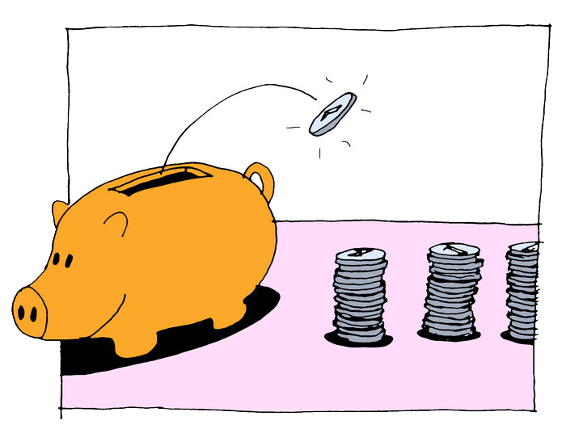
Longer employment = higher pension
The longer you work, the higher your old-age pension will be – you will accumulate more contributions that will be adjusted, and the average life expectancy rate will be lower.

Slide 8
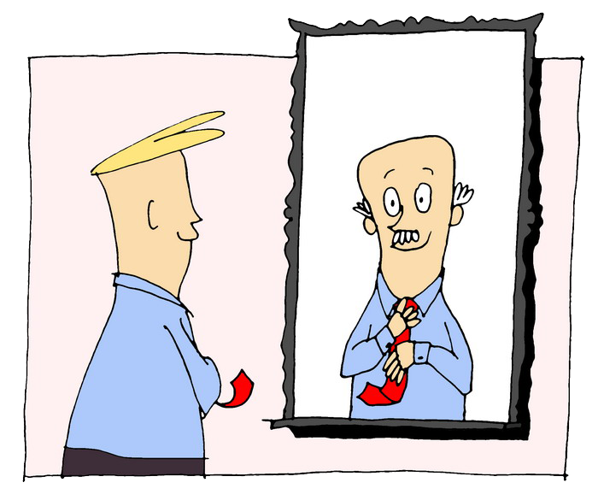
Three pillars
2018 r.
2062 r.
1ST PILLAR
ZUS account
2ND PILLAR
OFE, ZUS subaccount
3RD PILLAR
IKE, IKZE, PPE
Notes:
First pillar consists of the funds accumulated in the Social Insurance Fund.
Second pillar consists of the funds from the open pension fund (OFE) and from the sub-account in ZUS. If a person does not have an account in OFE, his second pillar is only a sub-account in ZUS.
Third pillar – individual old-age pension accounts (IKE), individual retirement protection accounts (IKZE), employee pension programmes (PPE).
IKE and IKZE are forms of individual voluntary saving for retirement in the third pillar, which entail tax relieves. Contributions to IKE and IKZE cannot exceed a certain limit in a calendar year. In 2017, it is PLN 12,789 in case of IKE, and PLN 5,115.60 in case of IKZE.
PPE is a voluntary form of group saving for retirement, organized by the employer with the participation of employees. The collected funds are paid into investment funds selected by the employee. The basic contribution is not included in the remuneration that forms the basis of compulsory social security contributions. The PPE participant may declare an additional contribution.

Slide 9
Retirement age in Poland
Women can retire when they are at least 60 years old and men 65. You may apply for an old-age pension right after completing 60 or 65 years. It's a right, not an obligation.

Slide 10
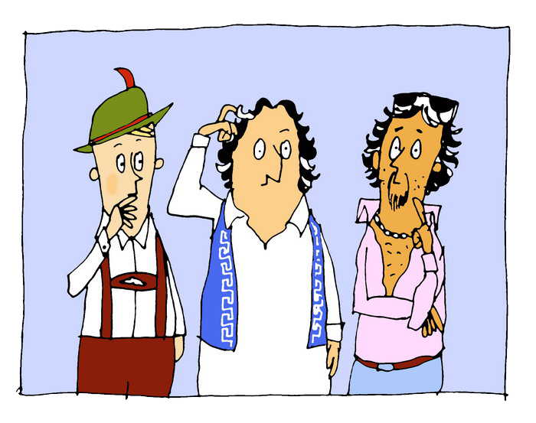
Retirement age in Europe
Notes:
Here you may refer to supplementary material No. 2.

Slide 11
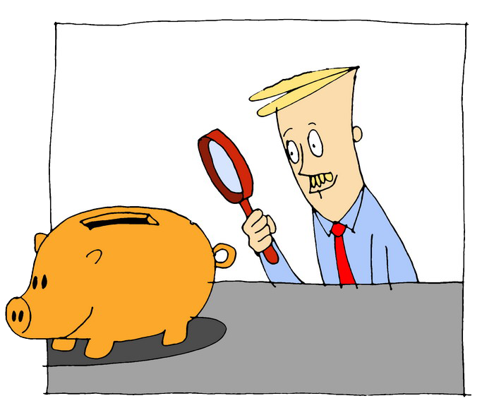
How to check the forecasted amount of your old-age pension?
You can calculate it on the ZUS Electronic Services Platform (PUE ZUS) or on www.zus.pl.
You can ask a pension adviser in ZUS.
Calculating the amount of the forecasted pension will allow you to choose the best time to retire for you.
Notes:
Launched on 14 June 2012 Electronic Services Platform ZUS (PUE ZUS) is nothing else than ZUS on the Internet (www.zus.pl). Thanks to this modern form of contact with ZUS, most matters related to social insurance can be settled electronically, including information about the benefits granted and the dates of their payment.
Telephone Service Centre number is 22 560 16 00. Consultants work from Monday to Friday from 7 a.m. to 6 p.m.

Slide 12
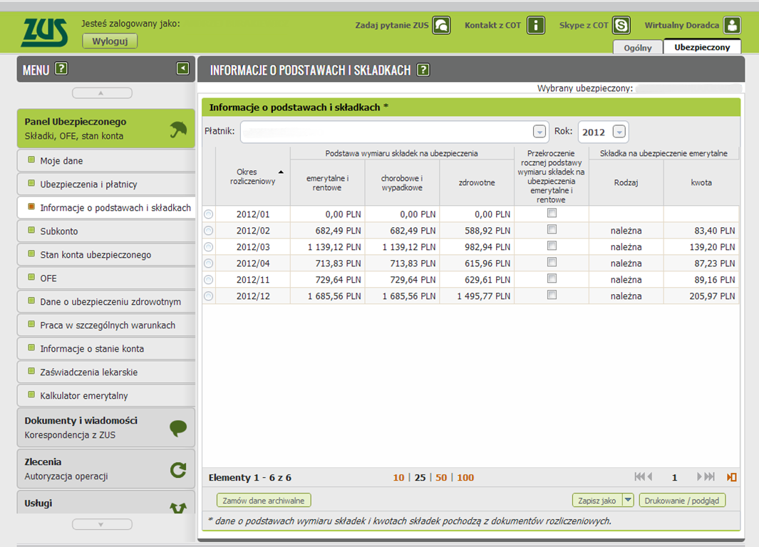
How to check your account balance in ZUS?
Notes:
The website presents the profile of an insured person and a list of paid contributions for given months. An insured person can check if the employer pays contributions for him on the insured person’s account at PUE ZUS.

